Slide 1

Comparing Web Services to Other Technologies

Slide 2
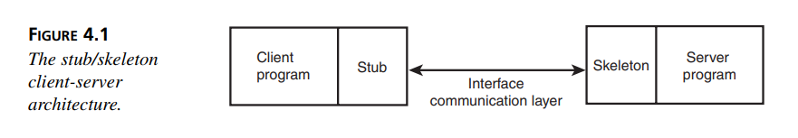
Stub/Skeleton Based Architectures
Takes care of the communications to get the data from client to server and vice versa
marshals (encodes) all calls from the client to the server into a format that the interface layer can understand.
It also unmarshals (decodes) any data coming back from the server into something the client can understand.

Slide 3
CORBA
Language Neutral
Multiple Vendors

Slide 4

Java RMI
Similar to CORBA
Requires that a specific port be opened for communications between the client and server
Compared to Web services, RMI is the better choice if both ends are Java based, but useless in non-Java guaranteed situations

Slide 5
DCOM
Is supported by multiple languages
Compared to Web services, DCOM solutions are nearly as capable for cross-language development.

Slide 6
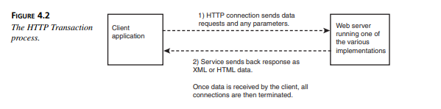
HTTP Transactional-based Architectures
The second category of Client/Server architectures is based on the familiar Web server paradigm.
These systems operate by having some piece of code running on a server similar to (or extending) a Web server such as IIS or Apache.
Clients communicate with
the server code through the familiar HTTP or HTTPS; the server handles the request and performs the work, responding with whatever data was requested (typically with HTML or XML text as the response).

Slide 7
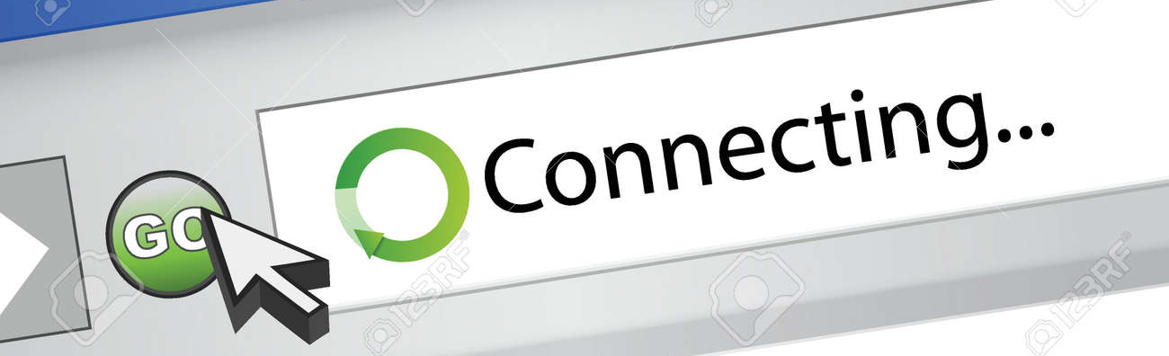
Downside
The downside of these systems is that because the connection is not persistent, in situations in which clients make a large number of discreet transactions with the server, a large percentage of time is wasted creating and terminating connections. In such situations, the stub/skeleton architectures tend to be better.

Slide 8
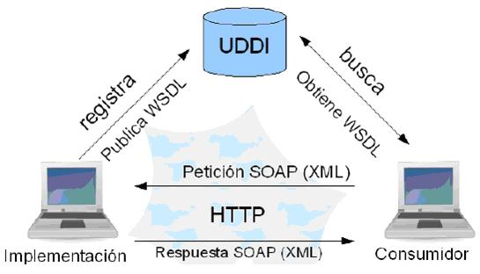
Another strike against these types of solutions is the lack of a directory service such as UDDI (Universal Description, Discovery and Integration).
Clients must know of the service in advance, must know what data the service expects, and must know how the service expects to receive that data.

Slide 9

One advantage that these solutions have over their stub/skeleton counterparts is that these solutions all communicate over the familiar HTTP ports.
Most networks leave the common HTTP and HTTPS ports (80 and 81, respectively) open for communications, so usually no additional work is required to get a solution based on these technologies deployed
on the network.

Slide 10

CGI
CGI is a mechanism by which when data is sent to the server, the Web server can invoke a program (the CGI) and pass all the data that was sent along with the request to the program. The CGI program processes the data and builds up a response page that it then sends back to the user

Slide 11

CGI Downsides
The CGI solution does have problems though. Developers quickly found that for popular sites using CGI, the Web servers needed to be rather large. Every request to the server caused a new instance of the CGI program to be instantiated, run, and then terminated.

Slide 12
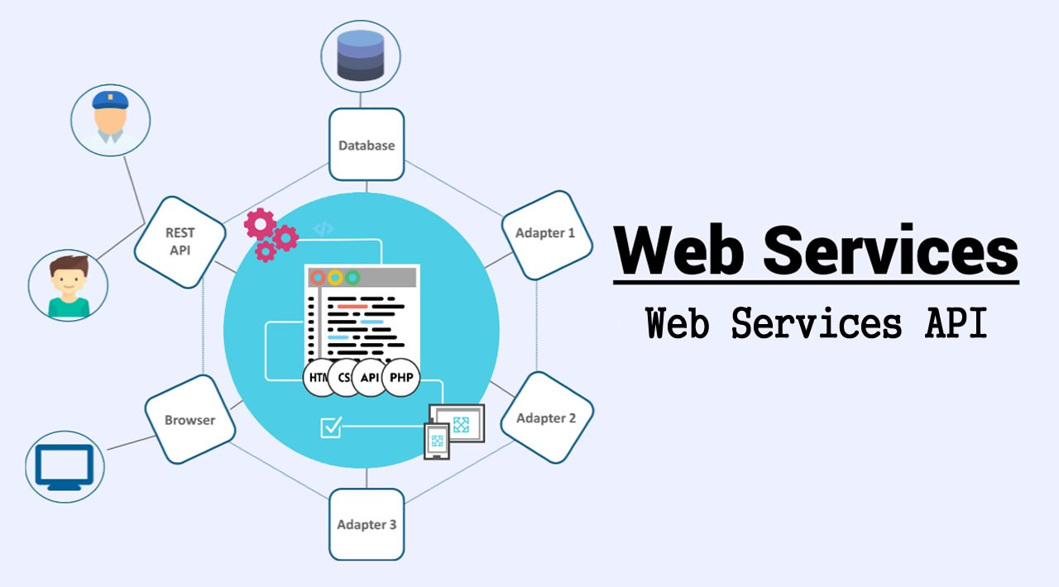
Comparison
Compared to Web services, CGIs are
• Harder to find because of no directory service
• Harder to write clients for without a well-documented service-specific API to rely on
• Harder to interact with programmatically because there’s no accepted data interchange format
• All over the place on nearly any Web server or platform

Slide 13

Servlets/JSP
Java servlets provide all the same capabilities as their CGI heritage, but without the resource penalty. Instead of running as a program, servlets are inherently multithreaded.
Each request invokes a new lightweight thread instance instead of the heavyweight process instances used by CGIs.
Servlets can respond to more than just HTTP requests. It is possible to build servlets to accept nearly any protocol.

Slide 14
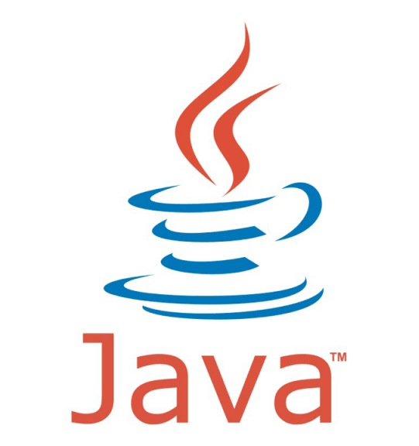

Comparison
• Servlets can only be written in Java.
• Servlets are harder to write clients for without a well-documented service-specific API to rely on.
• Servlets are harder to interact with programmatically because there’s no accepted data interchange format.
• Servlets can be found on many Web server platforms.

